Slide 1
A Study Of
The Book Of Revelation
June 7, 2020

Slide 2
Resources used:
A Study Of The Book Of Revelation by Bob Dodson
More Than Conquerors by William Hendriksen
Overcoming With The Lamb, Florida College Annual Lectures, February 7-10, 1994
Revelation: An Introduction and Commentary by Homer Hailey
Revelation (Truth Commentaries) by Robert Harkrider
Revelation (A Study Workbook) by Robert Harkrider
Revelation by Donnie Rader
Studies In The Book Of Revelation by Ferrell Jenkins
The Old Testament In The Book Of Revelation by Ferrell Jenkins
The Revelation Of Saint John The Divine by G.B. Caird
The Book of Revelation by Foy E. Wallace
The Avenging of the Apostles and Prophets by Arthur M. Ogden
Worthy Is The Lamb by Ray Summers
Written exchange on “The Domitian Persecution” between Arthur M. Ogden and Ferrell Jenkins presented in Searching The Scriptures, June 12, 1989, pages 7-12

Slide 3
Revelation 2:8-11
Letter to the church at Smyrna
“The Poor-Rich Church”

Slide 4
Letters To Seven Churches of Asia
(Revelation 2-3)
Some were good (Smyrna, Philadelphia)
Some were good / bad (Ephesus, Pergamum, Thyatira, Sardis)
One was bad (Laodicea)

Slide 5
Revelation 2:8-11
“Letter to the Church at Smyrna”
The Church Under Pressure
  Identification of the author (verse 8)
  Commendation (verse 9)
  Promise if they overcome (verses 10-11)

Slide 6
Revelation 2:8-11
“Letter to the Church at Smyrna”
The Church Under Pressure
Key Verse
Revelation 2:10
“Do not fear any of those things which you are about to suffer. Indeed, the devil is about to throw some of you into prison, that you may be tested, and you will have tribulation ten days. Be faithful until death, and I will give you the crown of life.” (NKJV)

Slide 7
The Church At Smyrna
(Revelation 2:8-11)
Get a letter – Circumstances Are Bad and Going To Get Worse!
Dear Smyrna,
Be Faithful Until Death.
A Church Under Pressure

Slide 8
The Church At Smyrna
(Revelation 2:8-11)
One of the two “good” churches – No condemnation.
Shortest of the 7 letters.
A poor church (by world’s standards), but rich (faith, strength, etc.).
How the church began we are not told – May have been the result of Paul’s preaching in Asia (cf. Acts 19:10)

Slide 9
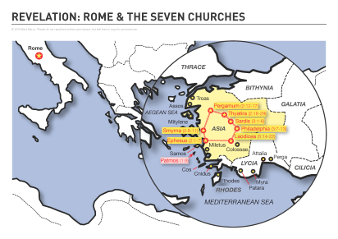
40 miles north of Ephesus. Both prosperous cities, each possessing active shipping trade that made them thriving centers of commerce.
Birthplace of Greek Poet Homer.
Known for its idolatry. Center for the worship of Dionysus.
Erected a shrine to Roma (Roman goddess) 195 BC.
Chosen for site of Temple to Tiberius (under his reign 14-37 AD).
Emperor worship compulsory under Domitian.
S
M
Y
R
N
A

Slide 10
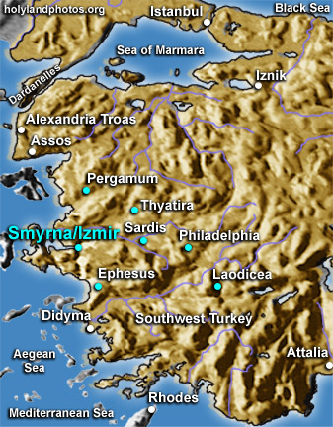
Smyrna
Courtesy of:
www.holylandphotos.org

Slide 11
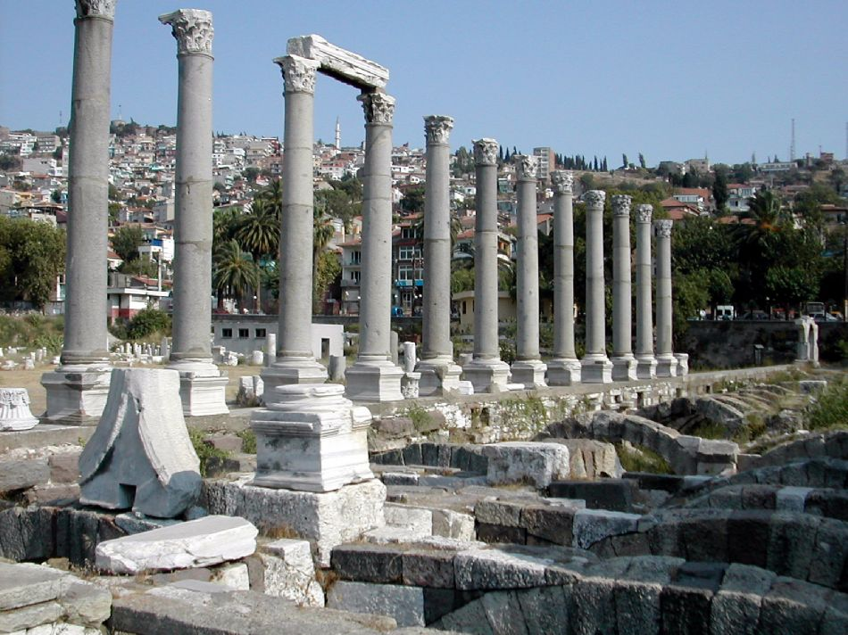

Slide 12
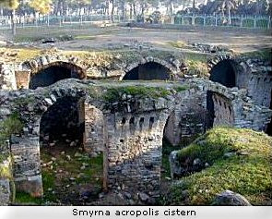
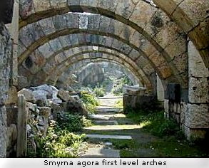
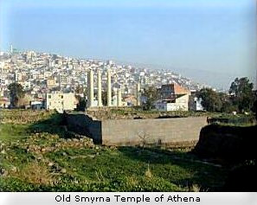
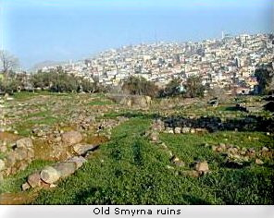

Slide 13
The Church At Smyrna
(Revelation 2:8-11)
2:8, “These things saith the first and the last, who was dead, and lived (again)” cf. 1:18; cf. 1:8; 22:13

Slide 14
Revelation 2:8-11
A Church Under Pressure
Revelation 2:8-11
Their Challenges
Evidently at Pergamos, Thyatira, and other cities many Christians weakened, but the church at Smyrna stood as one the Lord could praise.

Slide 15
Revelation 2:8-11
Their Challenges
A. “I know thy tribulation” (verse 9)
1. Persecution – thlipsis – “a pressing, pressing together, pressure” (Thayer).
2. Pictures grapes in winepress – crushed and trampled under feet or the grinding of wheat.
Each become of greater service.
Tribulation must not discourage us. 2 Timothy 3:12;
1 Thessalonians 3:1ff James 1:2ff; 1 Peter 1:1; 4:12ff

Slide 16
Revelation 2:8-11
Their Challenges
“I know thy tribulation” (verse 9)
The Lord has not promised to remove troubles. He has promised to help us. Hebrews 2:17-18; 4:15-16; 13:5

Slide 17
Revelation 2:8-11
Their Challenges
A. Tribulation (verse 9)
B. “I know … thy poverty” (verse 9)
1. Economic pressure from influential Jews.
2. Confiscation of property by Domitian. (Summers)
3. cf. Laodicea. (3:17)
C. “(but thou art rich)”
Poor rich men. Luke 12:15-21; 16:19-31
Rich poor men. Mark 12:41-44
They were rich in what counted most. John 6:27;
Matthew 6:19-21; 16:26.

Slide 18
Revelation 2:8-11
Their Challenges
A. Tribulation (verse 9)
B. Poverty (verse 9)
C. “I know … the blasphemy of them that say they are Jews, and they art not, but are a synagogue of Satan” (verse 9) cf. John 8:32-44
1. Slander their character – name.
2. Perhaps refers to Jews who escaped persecution through compromise.
3. The blasphemy of those who say they are Jews … “synagogue of Satan.”

Slide 19
Revelation 2:8-11
Their Challenges
3. The blasphemy of those who say they are Jews … “synagogue of Satan.”
NOTE: The disciples of Christ are the true “Israel of God” (Galatians 6:16).
Membership in the covenant family of God is no longer by a fleshly birth, but those who are born again of water and the spirit are God’s covenant spiritual family (John 3:3-5; Romans 2:28-29; Philippians 3:3).
  Tradition says that in Smyrna the Jews eagerly informed the Romans where they might find Christians in order to persecute them.

Slide 20
Revelation 2:8-11
Compromise of Others Adds Pressure
Caesar worship – more political than religious
Could burn incense to Caesar saying “Caesar is Lord” and worship how you may – as long as you were loyal to Rome

Slide 21
Revelation 2:8-11
William Barclay: “One thing is clear. The burning of this pinch of incense was obviously not a test of man’s religious orthodoxy; it was a test of his political loyalty. In point of fact the Roman government was extremely tolerant. Once a man had made his sacrifice and received his certificate, he could then worship any god or goddess he chose, provided that worship did not conflict with public decency and order.

Slide 22
Revelation 2:8-11
“But if he refused to burn a pinch of incense, he was by his refusal automatically branded as a disloyal and disaffected citizen. With an Empire the size of the Roman Empire, no government could afford to have disaffected citizens who might become storm-centers of trouble. Therefore any man who refused to burn his pinch of incense was rendered by his very refusal an outlaw.” (pages 33-34)

